Slide 1
Data Sampling
Divya Choudhary

Slide 2

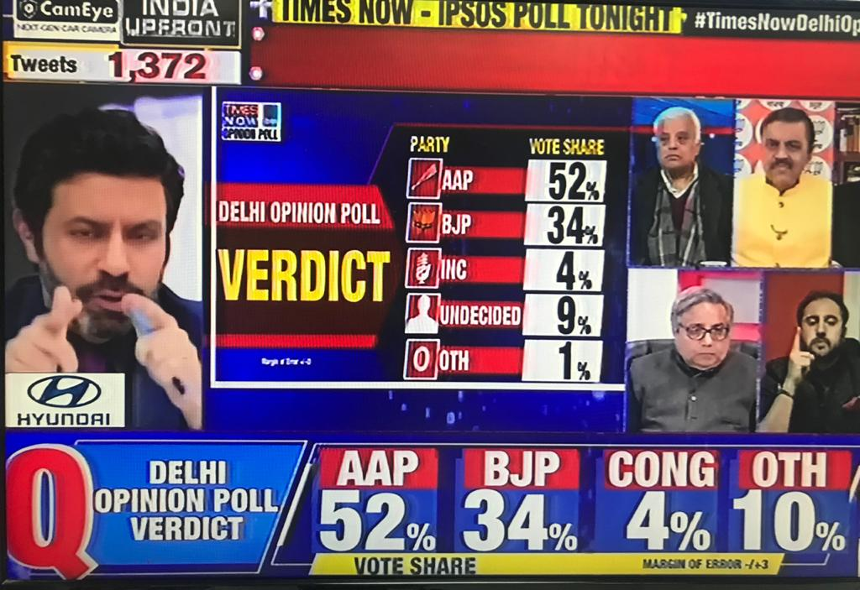
Sampling – What and Why
What is Sampling?
Selecting a subset of the entire Data, that is a good representation of the entire population
Population:
The entire group that you want to draw conclusions about
Sample:
The specific group of individuals that you will collect data from
Why is it needed?
1. Cost
Data collection involves cost
2. Representation
Meaningful insights require accurate representation of population
3. Computational efficiency
Data Storage, Computation time

Slide 3
How to perform Sampling
Example:
Perform a study on Student behavior at College X.
Number of Students = 1000 students in the college.
Define the population
Define the Sampling Frame
Calculate sample size
Choose Sampling Strategy
Population
Sampling Strategies
Probability
Simple Random
Non Probability
Convenience
Systematic
Stratified
Cluster
Purposive
Voluntary
Snowball
All 1000 Students
Student database
S3
S2
S1
Source: https://www.scribbr.com/methodology/sampling-methods/
Sample size calculators
https://www.qualtrics.com/au/experience-management/research/determine-sample-size/
https://www.surveymonkey.com/mp/sample-size-calculator/

Slide 4
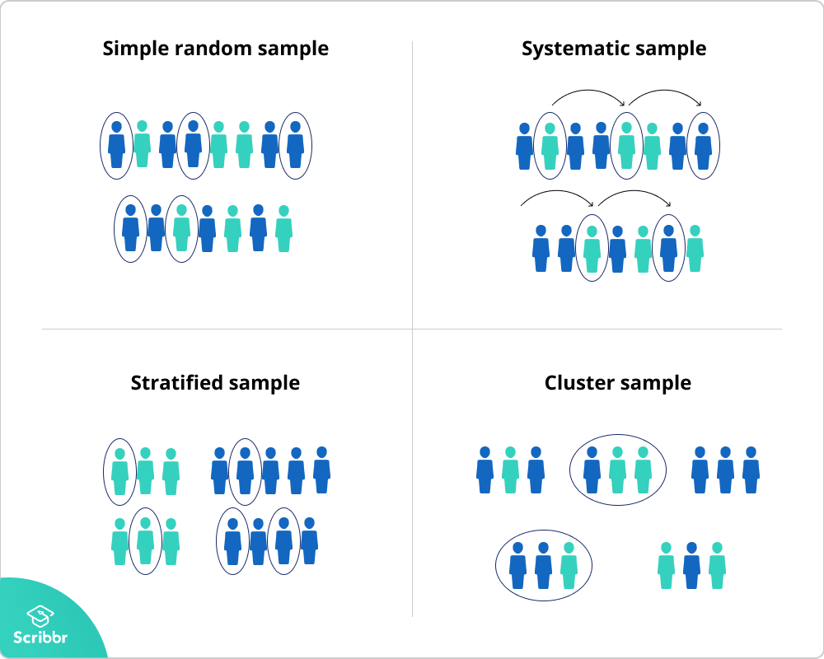
Simple Random Sampling
Sampling Strategies
Probability
Simple Random
Non Probability
Convenience
Systematic
Stratified
Cluster
Purposive
Voluntary
Snowball
Example
Bias?
Every member of the population has an equal chance of being selected. The sampling frame should include the whole population
Qn: How happy are you with your decision to join the college?
You want to select a simple random sample of 100 students of College X.
You assign a number to every student in the database from 1 to 1000, and use a random number generator to select 100 numbers.
No Bias

Slide 5
Systematic Sampling
Sampling Strategies
Probability
Simple Random
Non Probability
Convenience
Systematic
Stratified
Cluster
Purposive
Voluntary
Snowball
Example
Bias?
Similar to SRS, but not completely random. Every member of the population is listed with a number, but instead of randomly generating numbers, individuals are chosen at regular intervals.
Qn: How happy are you with your decision to join the college?
All students are listed in alphabetical order.
From the first 10 students, randomly select a starting point: #6.
From number 6 onwards, every 10th person on the list is selected (6, 16, 26, 36 … 986, 996),
and you end up with a sample of 100 people.
Underlying patterns in data might lead to bias
Eg: Student Database lists students by Sections, and within Sections they are sorted by years of work experience.
The skip interval might skip over some years in every section

Slide 6
Stratified Sampling
Sampling Strategies
Probability
Simple Random
Non Probability
Convenience
Systematic
Stratified
Cluster
Purposive
Voluntary
Snowball
Example
Bias?
Population has mixed characteristics, and you want to ensure that every characteristic is proportionally represented in the sample
Qn: How happy are you with your decision to join the college?
The college has 800 female students and 200 male students.
You want to ensure that the sample reflects the gender ratio of the college, so you sort the population into two strata based on gender.
Then you use random sampling on each group, selecting 80 women and 20 men, which gives you a representative sample of 100 people.
By design its carrying the characteristics of the population

Slide 7
Cluster Sampling
Sampling Strategies
Probability
Simple Random
Non Probability
Convenience
Systematic
Stratified
Cluster
Purposive
Voluntary
Snowball
Example
Bias?
Involves dividing the population into subgroups, but each subgroup should have similar characteristics to the whole sample. Instead of sampling individuals from each subgroup, randomly select entire subgroups.
Qn: How happy are you with your decision to join the college?
The college has 5 locations – 3 domestic and 2 international.
You don’t have the funds to travel to every location to collect your data
So use random sampling to select 3 locations – these are the clusters.
Difficult to ensure that each clusters is truly representative of the population

Slide 8
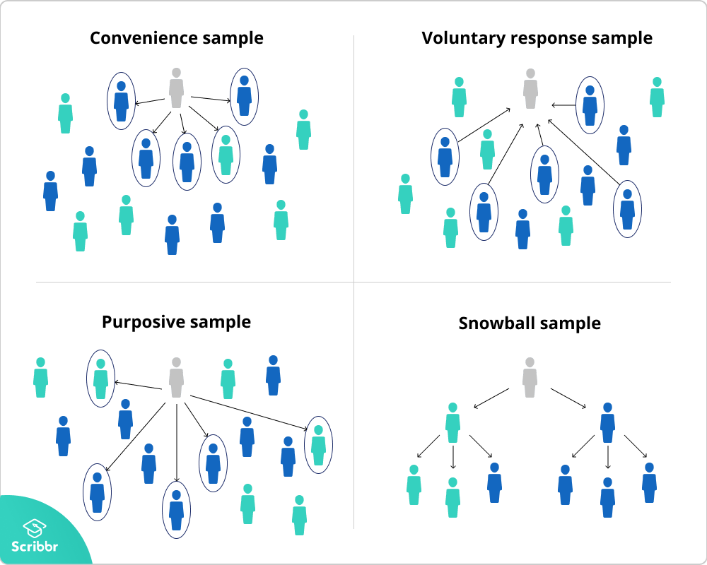
Convenience Sampling
Sampling Strategies
Probability
Simple Random
Non Probability
Convenience
Systematic
Stratified
Cluster
Purposive
Voluntary
Snowball
Example
Bias?
Includes the individuals who happen to be most accessible to the researcher.
Qn: You are researching influence of CAT score on placement salary.
So after every class, you ask your classmates to complete a survey on the topic.
Convenient, but..
… Non generalizable - only surveyed students taking the same electives as you
The sample is not representative of all the students at your college.

Slide 9
Voluntary Response Sampling
Sampling Strategies
Probability
Simple Random
Non Probability
Convenience
Systematic
Stratified
Cluster
Purposive
Voluntary
Snowball
Example
Bias?
Instead of the researcher choosing participants and directly contacting them, people volunteer themselves
Qn: Survey on cafeteria food of your college put up on college FB page
a lot of students decide to complete it.
Always somewhat biased, as some people will inherently be more likely to volunteer than others.
The people who responded are more likely to be those who have strong opinions about the food.
Can’t be sure that their opinions are representative of all students.

Slide 10
Purposive Sampling
Sampling Strategies
Probability
Simple Random
Non Probability
Convenience
Systematic
Stratified
Cluster
Purposive
Voluntary
Snowball
Example
Bias?
The researcher using their judgement to select a sample that is most useful to the purposes of the research.
Qn: You want to know more about the opinions and experiences of female students during MBA
So you purposefully send the survey to only female students
Used in qualitative research, where the researcher wants to gain detailed knowledge about a specific phenomenon
An effective purposive sample must have clear criteria and rationale for inclusion.

Slide 11
Snowball Sampling
Sampling Strategies
Probability
Simple Random
Non Probability
Convenience
Systematic
Stratified
Cluster
Purposive
Voluntary
Snowball
Example
Bias?
When population is hard to access, snowball sampling can be used to recruit participants via other participants
Qn: Study the effect of PhD on placement salaries
You don’t know many PhD students at college.
So you contact the 1 PhD student you know and ask them to pass on to their circle
The 1st person’s influence may trickle to subsequent participants

Slide 12
Sampling during model building
Over sampling and undersampling

Slide 13
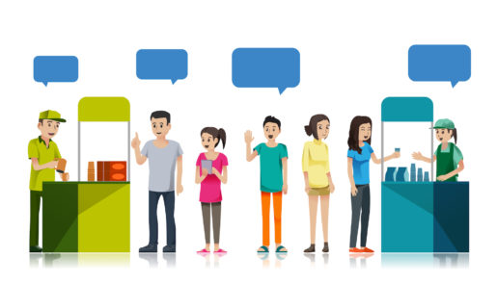
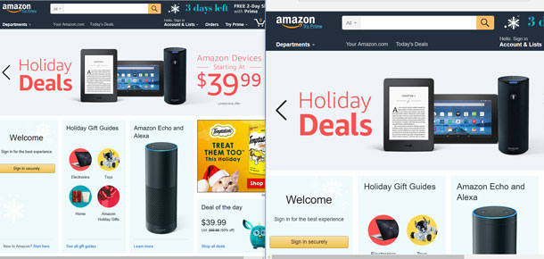
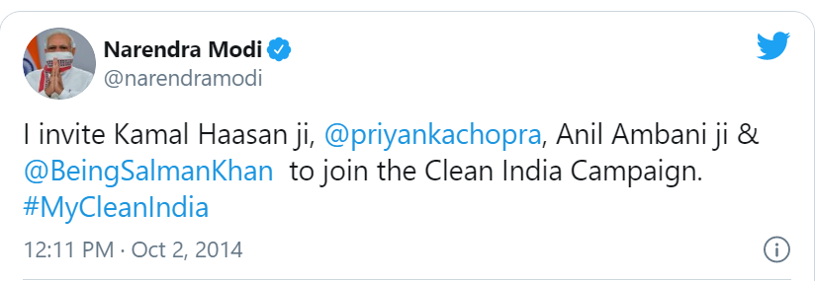
Audience Quiz
A/B Testing ,Reservoir Sampling
Product Samples in Shops
Purposive
Random
Social Media challenges, WhatsApp forwards
Snowball + Purposive

Slide 14
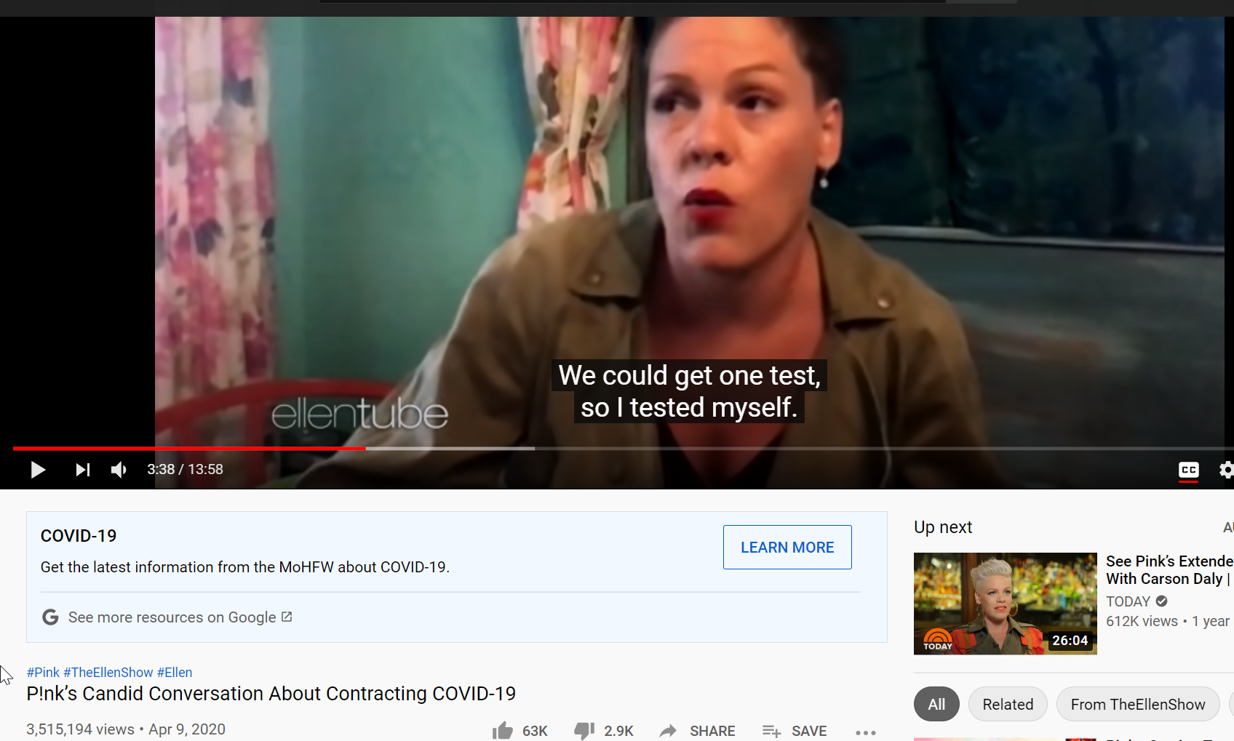

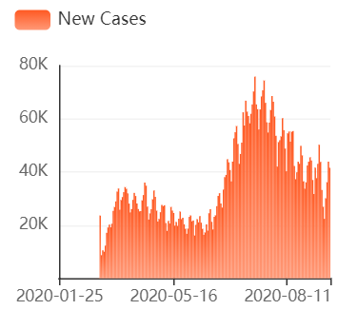
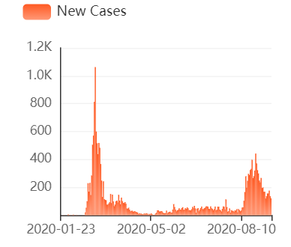
COVID TESTING
Convenience
Random + Voluntary
USA Testing rules during early March 2020:
History of travel to COVID affected countries
In contact with a COVID positive person
Showing symptoms
S.Korea Testing rules during early March 2020:
No Restrictions – Free testing for all

Slide 15
Thank You

